Slide 1
CSCI 4110 Local Illumination
Mark Green
Faculty of Science
UOIT

Slide 2
Illumination
Determine the colour value at each pixel, this is one of the main research areas in graphics
Two broad approaches:
Local illumination – based on the information available at the current pixel or point on object
Global illumination – based on light transfer in the entire environment
Significant time/accuracy trade off
Local illumination is very fast, can be done in hardware or a GPU program, many images per second

Slide 3
Illumination
Global illumination is very slow, can take hours to produce a single image
Significant quality difference, global illumination used for photorealistic rendering
Local illumination tends to look like plastic
Global illumination algorithms have much more information, anything in the scene, so can do a much better job
But, the extra information can take much longer to process

Slide 4
Local Illumination
Can only use information available at the current pixel:
Local material properties
Light sources
Some techniques are based on physics, while others are based on what looks good
Light reflection divided into three components:
Ambient
Diffuse reflection
Specular reflection

Slide 5
Local Illumination
First relatively complete model was the Phong model, still used today
Ambient light: the background illumination in the environment, caused by inter-reflections not considered in the model
The environment has an ambient light level I_{a} and each object has an ambient light coefficient k_{a}
the ambient light level is given by:
I_{g} = I_{a}k_{a}

Slide 6
Local Illumination
Diffuse illumination: reflected light the same in all directions, a flat reflection
Amount of light reflected depends upon incident light, light coming from each light source, I_{i}
The amount of received light depends upon the angle θ between L_{i} and N, the normal to the surface at the point:
I_{d} = I_{i}k_{d}cosθ = I_{i}k_{d}(N • L_{i})
We assume that all vectors have been normalized

Slide 7
Local Illumination
Specular reflection: shiny highlight, in the general direction of a mirror reflection
Vector to light source L and reflection direction R make same angle α to the normal N, see next slide
Perfect reflection will only be along R, only visible in one direction
Most materials aren’t perfect reflectors, light reflected in a cone around R, size of cone depends upon shininess of material
How does light intensity vary within the cone?

Slide 8
Local Illumination
N
R
L
V
θ
α
α

Slide 9
Local Illumination
Phong approximated the light intensity with a cosine to a power, no basis in physics, but matches a number of real surfaces:
I_{s} = I_{i}k_{s}cos^{n}θ = I_{i}k_{s} (R•V)^{n}
R = -L + 2(L•N)N
The value of n determines the shininess of the surface, with larger values producing shinier surfaces
Computing the R direction is costly, particularly on a pixel by pixel basis

Slide 10
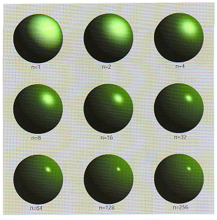
Local Illumination
Specular reflection for different values of the shininess, n

Slide 11
Local Illumination
An optimization is to use the half vector:
H = (V+L)/2
This is easier to compute and gives similar results
For colour the ambient and diffuse components have the colour of the object and the specular component has the colour of the light source
For multiple light sources the contributions from the light sources are summed
Since this is not a physical model we can get overflow in the colour computations

Slide 12
Local Illumination
One addition to the model is attenuation with distance from light source
If the distance to the light source is d, the correct attenuation is 1/d², but quite often we use a more general model:
f(d) = 1/(c₁ + c₂d + c₃d²)
f(d) is computed for each light source and modifies the contribution from that light

Slide 13
Local Illumination
The Phong model is used in the fixed function pipeline of OpenGL and DirectX
Evaluated at the vertices and then interpolated across the surface of the polygon
Programmable GPU, can use any program to compute intensity
GPU still computes local illumination, each pixel is processed separately without access to data at other pixels, or the rest of the model

Slide 14
Local Illumination
Phong model still used with GPUs, except now we can evaluate the model at every pixel, gives a better result for shiny objects
Can be implemented in a few lines of shader code
There are a number of more sophisticated models that attempt to model the physics of surfaces
Mathematics more complex and still only an approximation to real materials
Usually require a few pages of shader code, not nearly as fast as the Phong model

Slide 15
Textures
The Phong model gives us rather bland surfaces often described as plastic or metal
We could use better models of specular reflection, but they are still restricted to local information and don’t do much better
Textures give us a way of producing more interesting surfaces with just local information, started as a rather simple technique, but has evolved over the years
GPUs provide a number of interesting uses of textures

Slide 16
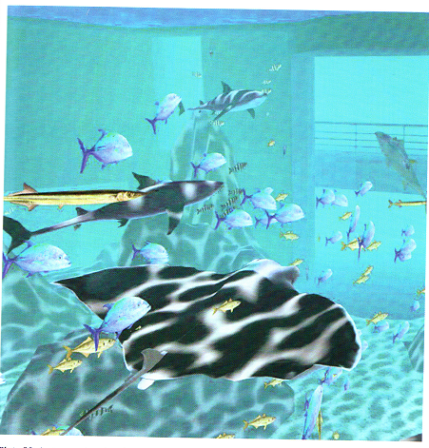
Textures

Slide 17
Textures
The original use of texture mapping was to place a 2D image on the surface of an object
Image stored as a 2D array of pixels, could come from a camera or computer generated
Idea was to basically take the image and paste it onto the surface
Need a mapping between the pixels on the surface and the pixels in the texture image, to reduce confusion the pixels in the texture image are usually called texels

Slide 18
Textures
Add texture coordinates to the surface, usually called (u, v), range from 0 to 1, range of texture coordinates covers the entire texture
If the texture is N x M pixels, then the coordinates (s, t) of the texel corresponding to (u, v) are:
s = uN
t = vM
We just need to look up the texel at (s, t) and use this as the colour of the pixel with texture coordinates (u, v)

Slide 19
Textures
The texel could be the final colour of the surface, or it could be used as the object colour in the Phong model
This gets the image onto the surface, but there are lots of questions, the most important are:
Where do the texture coordinates come from?
How do we filter the texture so it doesn’t look so bad?
The texture coordinate space is a 2D space, we need to somehow generate these coordinates and store them with the surface

Slide 20
Textures
In the case of a parametric surface this is easy, we just use the (u, v) parameters from the surface
For polygonal models this is a much harder problem
We can assign the texture coordinates by hand, some geometrical modellers support this, but it soon gets very tedious
Some of the procedural modeling techniques will also generate the texture coordinates
Frequently we will have a polygonal model and we will need to compute the texture coordinates

Slide 21
Textures
The computed texture coordinates are placed on the vertices and interpolated over the polygon faces
There are a range of techniques that can be used for this, none of them are universal, usually only work on specific types of shapes
Planar mapping is the simplest and works well for relatively flat objects
Conceptually a plane is constructed parallel to the object and a (u, v) coordinate system is constructed on the plane

Slide 22
Textures
A parallel projection is used to project the vertices onto the plane, which gives the (u, v) texture coordinates
Easiest if the plane is perpendicular to the x, y, or z axis – just drop one the x, y, or z coordinates and map the other two to (u, v)
Other planes are rarely used, since the math is more complicated
This is usually part of a more complicated texture coordinate computation

Slide 23
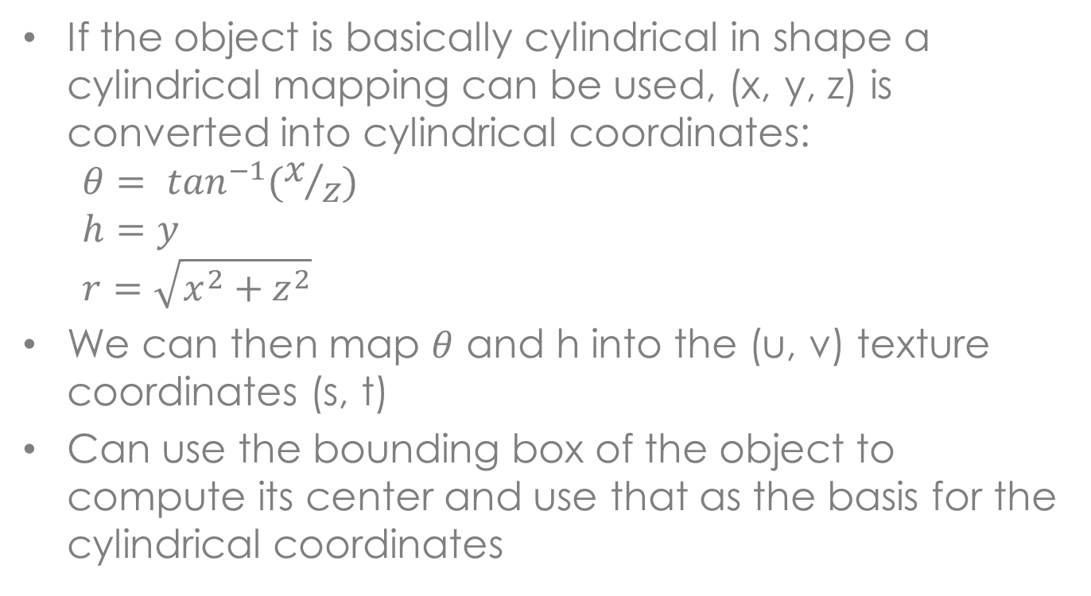
Textures
If the object is basically cylindrical in shape a cylindrical mapping can be used, (x, y, z) is converted into cylindrical coordinates:
$$θ= \tan^{−1}(x/z)$$
$$h=y$$
$$r=\sqrt{x^{2}+z^{2}}$$
We can then map $θ$ and h into the (u, v) texture coordinates (s, t)
Can use the bounding box of the object to compute its center and use that as the basis for the cylindrical coordinates

Slide 24
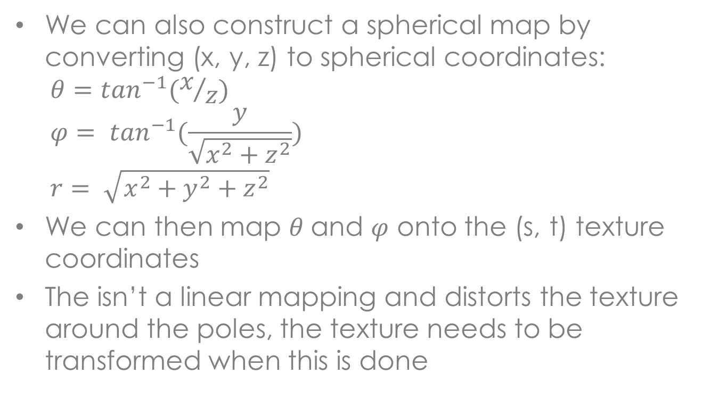
Textures
We can also construct a spherical map by converting (x, y, z) to spherical coordinates:
$$θ=\tan^{−1}(x/z)$$
$$φ= \tan^{−1}(\frac{y}{\sqrt{x^{2}+z^{2}}})$$
$$r= \sqrt{x^{2}+y^{2}+z^{2}}$$
We can then map $θ$and $φ$ onto the (s, t) texture coordinates
The isn’t a linear mapping and distorts the texture around the poles, the texture needs to be transformed when this is done

Slide 25
Textures
Now we get to the filtering part
If the texture was perfectly aligned with the surface and there was a one-to-one mapping between screen pixels and texels everything would be okay
But this is not the case:
A screen pixel could correspond to a small part of a texel (magnification)
A screen pixel could correspond to many texels (minification)
The texture could be rotated with respect to the screen

Slide 26
Textures
The first case really isn’t a problem
The third case is hard to do in real-time so we ignore it
The second case we can do something about
When a pixel covers several texels the issue is which texel do we use?
Selecting any one of them is wrong, we need to filter the texels before they are used
If we don’t do this our image will alias and the texture will look very bad

Slide 27
Textures
How do we do this filtering in real-time?
We have many pixels to texture map and they may cover many texels, this could quickly become very expensive
The answer is to pre-filter the texture, so we can use a simple lookup procedure at display time
This is only an approximation to correct filtering, but it does a reasonably good job
The standard way to do this is to use something called a mipmap, which is implemented on all graphics hardware

Slide 28
Textures
A mipmap is a hierarchical representation of the texture
Start with the original texture, this is the base level of the hierarchy
The next level is ¼ size of the original texture, simplest approach is to use a box filter on 2x2 regions of the original texture
This process continues until one of the dimensions is only one pixel
See the next slide

Slide 29
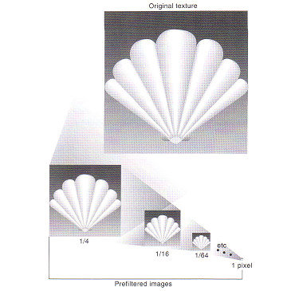
Textures

Slide 30
Textures
A mipmap takes up about twice the amount of space as a regular texture, so this is not overly expensive
OpenGL will automatically construct mipmaps for you, or you can compute the individual levels of the mipmap yourself
With the later you can use your own filtering algorithm
At display time the appropriate level of the mipmap is determined and the texel is retrieved

Slide 31
Textures
A more sophisticate approach is based on the observation that the appropriate level won’t be an integer, but will lie between two levels of the mipmap
A bilinear filter is used on each level, and the results are averaged to get the final texel value
This works quite well if the textures are reasonably well aligned with the object, the worst case occurs when there is a 45 degree angle between them
Pixels then map onto diamonds and not squares

Slide 32
Textures
We can also have 1D and 3D textures, with the obvious extensions:
1D or 3D textures coordinates
1D or 3D array of texels
Mipmaps
Everything works in basically the same way, except there is one more or one fewer coordinates
This covers the basics of texture mapping, but there are quite a few extensions to the idea

Slide 33
Textures
So far we have considered one texture, a variation on this is to have 6 textures, two for each coordinate plane in the positive and negative directions
See the next slide for how this is laid out
We now use a 3D texture coordinate (s, t, r), the coordinate with the largest magnitude determines the 2D image that we use
The other 2 coordinates are treated as standard 2D texture coordinates

Slide 34
Textures
+Y
+Z
-X
-Z
+X
-Y

Slide 35
Textures
There are multiple ways that we can compute the texture coordinates
In a box map either the normal vector at the vertex, or the vector from the center of the object to the vertex are used as texture coordinates
This is better than using a spherical map since there is less distortion around the poles, but we need to have 6 texture maps instead of one
Environment maps are quite often used for reflective objects to capture reflections of other objects in the environment

Slide 36
Textures
In this case we want the texture coordinates to map onto the reflected light direction from the eye’s perspective
The texture coordinates are typically generated in real-time, which can be done in hardware
We need two vectors, the unit vector u from the origin to the vertex/pixel and the normal vector n at the vertex, both of these must be in the eye coordinate system
Alternatively, in world coordinates u is the vector from the eye to the vertex/pixel

Slide 37
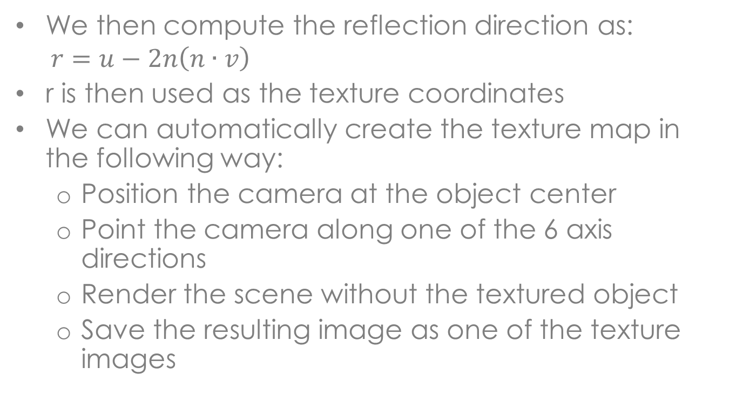
Textures
We then compute the reflection direction as:
$$r=u−2n\left(n∙v\right)$$
r is then used as the texture coordinates
We can automatically create the texture map in the following way:
Position the camera at the object center
Point the camera along one of the 6 axis directions
Render the scene without the textured object
Save the resulting image as one of the texture images

Slide 38
Textures
A relatively low resolution can be used for this, since the texture will only occupy part of the screen
This process can be repeated each time the image is rendered, or it can be done once at application initialization and only changed when something in the environment changes
This is a cheap way of getting effects that are similar to global illumination

Slide 39
Textures
So far we have only used textures for colour, but they can be used for other purposes
We can use textures at any point in the rendering process, it is basically an array lookup, we can have a value for each vertex or each pixel
On GPUs textures can be used in vertex programs to modify geometry
If the rendering is done in software we can do anything we like with textures

Slide 40
Textures
In displacement mapping textures are used to move vertices in polygonal meshes
The texture value is multiplied by the normal vector and the result is added to the vertex position
This can be used to add detail to the surface without a lot of geometrical modeling
The main problem with this approach is that a relatively fine mesh must be used, otherwise the surface becomes too rough and distorted
The main advantage is the geometry is actually changed

Slide 41
Textures
A similar effect can be achieved with a technique called bump mapping
This doesn’t change the geometry, instead it changes the normal vector
This is done at the pixel level, so we don’t need the fine mesh used in displacement mapping
Basic idea: displacement map changes the normal as well as the vertex position
In Phong model only the normal is used, not the position, so lighting only depends on normal
We can fake geometry by just changing normal

Slide 42
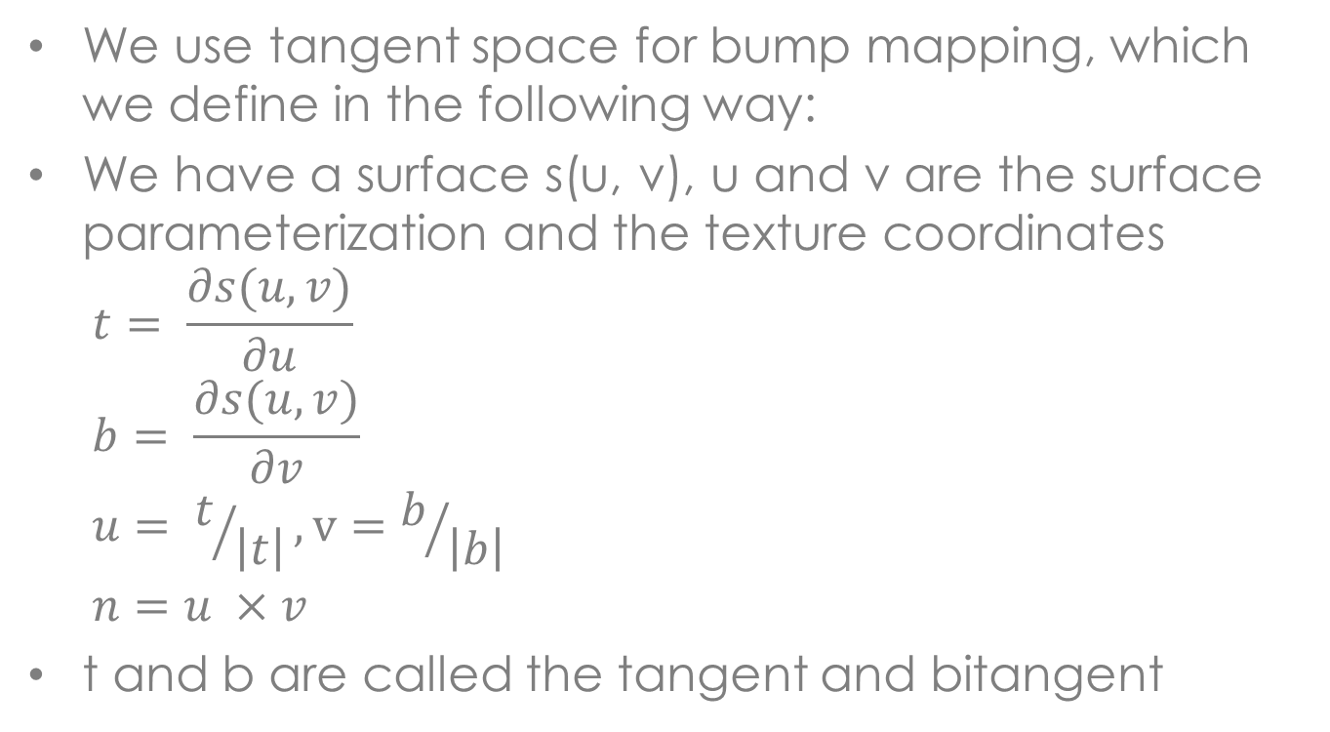
Textures
We use tangent space for bump mapping, which we define in the following way:
We have a surface s(u, v), u and v are the surface parameterization and the texture coordinates
$$t= \frac{∂s(u,v)}{∂u}$$
$$b= \frac{∂s(u,v)}{∂v}$$
$$u= t/{\left|t\right|}, v=b/{\left|b\right|}$$
$$n=u ×v$$
t and b are called the tangent and bitangent

Slide 43
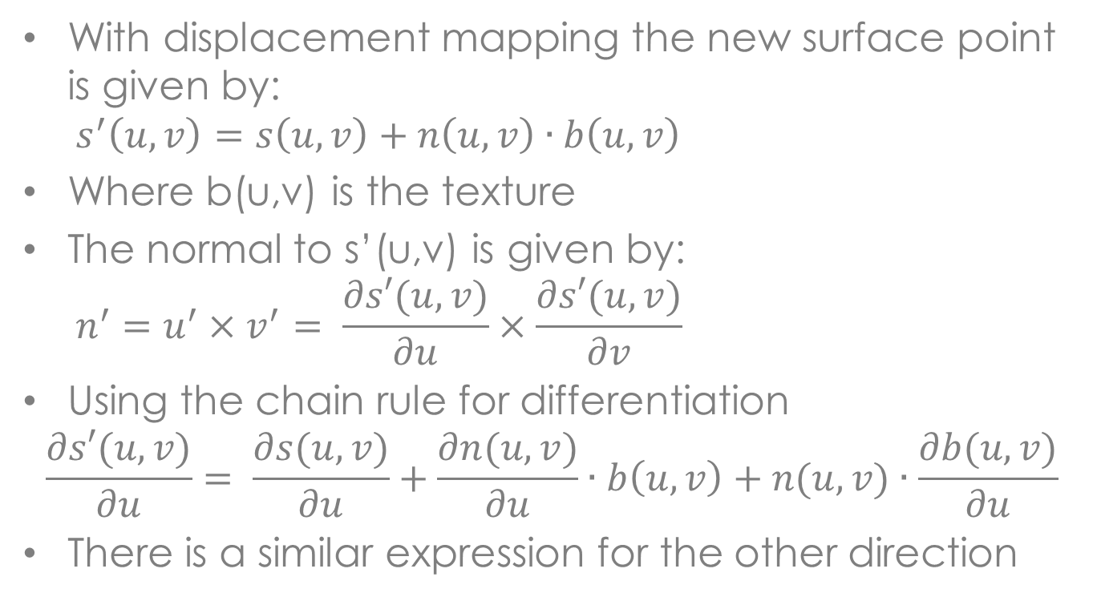
Textures
With displacement mapping the new surface point is given by:
$$s^{′}\left(u,v\right)=s\left(u,v\right)+n\left(u,v\right)∙b\left(u,v\right)$$
Where b(u,v) is the texture
The normal to s’(u,v) is given by:
$$n^{′}=u^{′}×v^{′}= \frac{∂s′(u,v)}{∂u}×\frac{∂s′(u,v)}{∂v}$$
Using the chain rule for differentiation
$$\frac{∂s′(u,v)}{∂u}= \frac{∂s(u,v)}{∂u}+\frac{∂n(u,v)}{∂u}∙b\left(u,v\right)+n(u,v)∙\frac{∂b(u,v)}{∂u}$$
There is a similar expression for the other direction

Slide 44
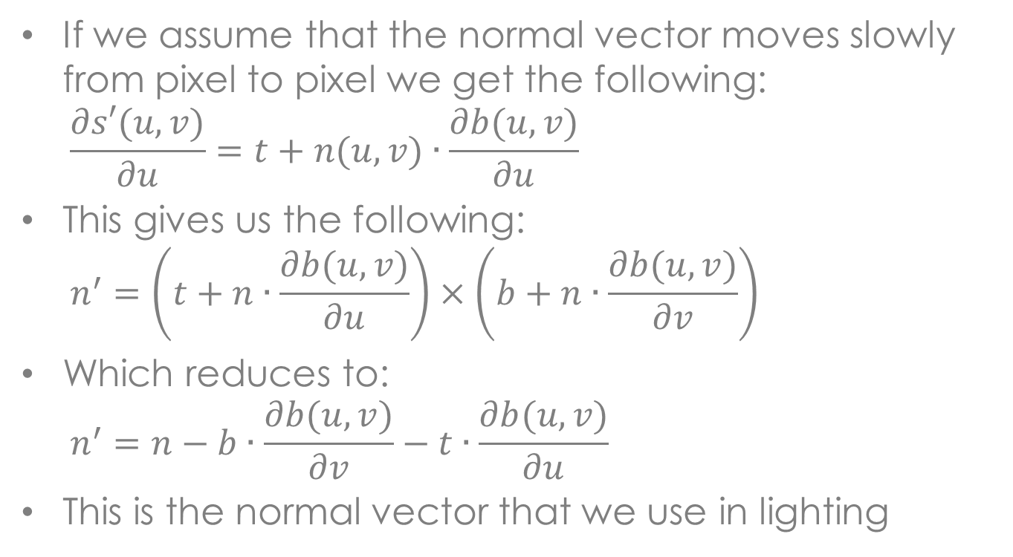
Textures
If we assume that the normal vector moves slowly from pixel to pixel we get the following:
$$\frac{∂s′(u,v)}{∂u}=t+n(u,v)∙\frac{∂b(u,v)}{∂u}$$
This gives us the following:
$$n^{′}=\left(t+n∙\frac{∂b(u,v)}{∂u}\right)×\left(b+n∙\frac{∂b(u,v)}{∂v}\right)$$
Which reduces to:
$$n^{′}=n−b∙\frac{∂b(u,v)}{∂v}−t∙\frac{∂b(u,v)}{∂u}$$
This is the normal vector that we use in lighting

Slide 45
Textures
We can also store normal vectors directly in the texture map, called a normal map
Can compute normal map from a high resolution model and then use a much lower resolution model for display
This produces good results, but there is a problem, normals don’t transform the same way as points, so we need to transform the texture to eye coordinates, or the results will be wrong when they are retrieved
An alternative is to use tangent space, which solves this problem

Slide 46
Procedural Textures
Just like we have procedural models, we also have procedural textures
Several advantages:
No resolution problems, can generate at any resolution that we need
Easier to construct complex textures
Most techniques generate 3D textures, also called solid textures
Solid textures have a texture value at each point in 3D space, not just on the object surface, why would we want this?

Slide 47
Procedural Textures
Solid textures provide internal structure, if the object is divided into several parts there will be texture on the inside
For some textures, like wood, it is easier to generate
We can have partially transparent textures, good for clouds and smoke
Object can enter region and will look like it is in the middle of a cloud or smoke, motion will be correct
Example of a marble procedural texture on the next slide

Slide 48
Procedural Textures

Slide 49
Procedural Textures
Many procedural textures are built on top of Perlin noise, this is a random process defined on R³ that has several interesting properties:
Rotation invariant
Translation invariant
Time invariant
Band limited – remove low and high frequencies from random process
Perlin has called it a spline surface on random knots, and it’s related to fractals

Slide 50
Procedural Textures
Perlin noise is defined on an integer lattice, we generate random values that are stored at the lattice points
A form of spline interpolation is used to compute a value at any point in R³
Determine the cube that the point is in, and then interpolate the values at the 8 corners
The value we store at the lattice points is a random gradient of the process and not the process value itself, assumed to be zero at lattice points

Slide 51
Procedural Textures
There are two things that we need to do:
Compute the random values at the lattice points, this is done once at the start of the computation
Interpolate lattice point values to get our random sample
They will be described separately
We could construct a 3D array for storing lattice point values, but this requires a lot of storage and we need to know the size of the space
Instead we construct a 1D array, G, of random gradients and then map the lattice points into this array

Slide 52
Procedural Textures
The random gradients must lie on the surface of the unit sphere
This is done by generating random 3D vectors, those with a length less than 1 are normalized and stored
Perlin uses a table of length 256 for the gradients
A hash function is used to map from lattice points to the gradient table
This hash function is based on a permutation table P that contains integers from 0 to 255, a single pass of random swaps produces the permutations

Slide 53
Procedural Textures
Given the lattice coordinates i, j, k, the fold(i,j,k) procedure computes the table index in the following way:
n = P[i % 256]
n = P[(n+j) % 256]
n = P[(n+k) % 256]
Perlin uses two copies of the table in a single array, so the % operation isn’t required
Given a lattice point the random gradient is G[fold(i,j,k)]

Slide 54
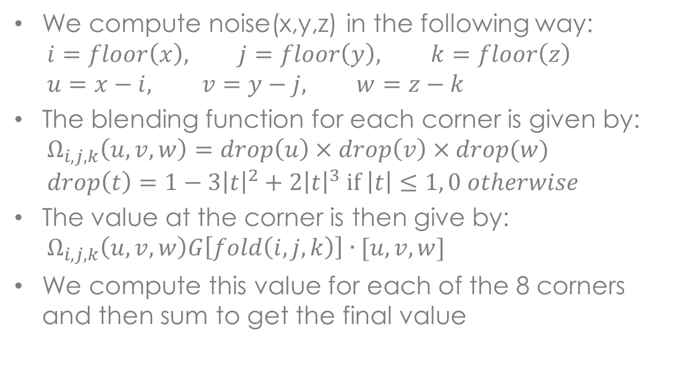
Procedural Textures
We compute noise(x,y,z) in the following way:
$$i=floor\left(x\right), j=floor\left(y\right), k=floor\left(z\right)$$
$$u=x−i, v=y−j, w=z−k$$
The blending function for each corner is given by:
$$Ω_{i,j,k}\left(u, v, w\right)=drop\left(u\right)×drop\left(v\right)×drop(w)$$
$$drop\left(t\right)=1−3{\left|t\right|}^{2}+2{\left|t\right|}^{3} if \left|t\right|≤1, 0 otherwise$$
The value at the corner is then give by:
$$Ω_{i,j,k}\left(u,v,w\right)G\left[fold\left(i,j,k\right)\right]∙[u, v, w]$$
We compute this value for each of the 8 corners and then sum to get the final value

Slide 55
Procedural Textures
The noise function is used as the basis for many procedural textures
It is used to build the turbulence function, which is even more popular
Turbulence combines the noise function at different frequencies and scales
For a point p, noise(2p) has twice the frequency as noise(p)
The points are moving through the texture twice as fast, so we get a higher frequency

Slide 56
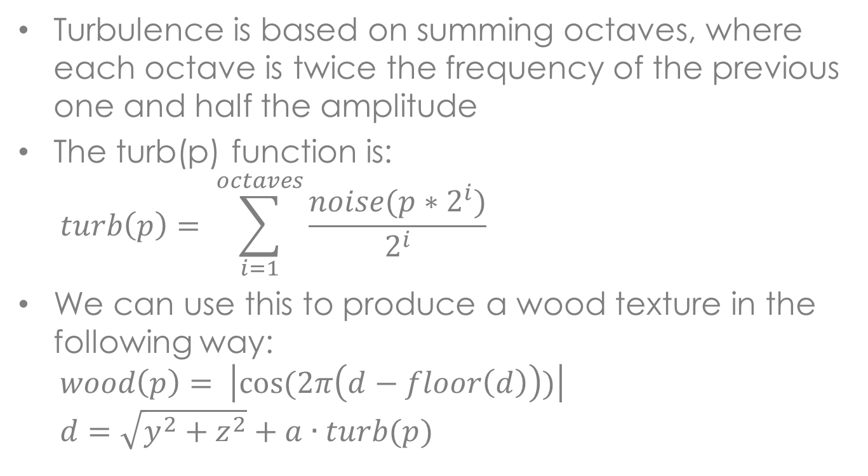
Procedural Textures
Turbulence is based on summing octaves, where each octave is twice the frequency of the previous one and half the amplitude
The turb(p) function is:
$$turb\left(p\right)= \sum_{i=1}^{octaves}{\frac{noise(p∗2^{i})}{2^{i}}}$$
We can use this to produce a wood texture in the following way:
$$wood\left(p\right)= \left|cos⁡(2π\left(d−floor\left(d\right)\right))\right|$$
$$d=\sqrt{y^{2}+z^{2}}+a∙turb(p)$$

Slide 57
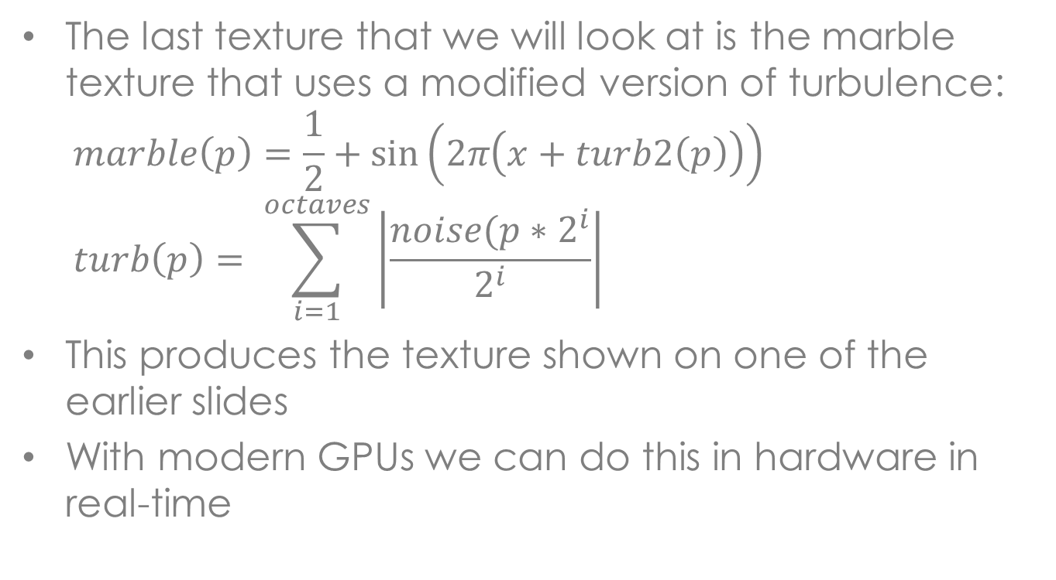
Procedural Textures
The last texture that we will look at is the marble texture that uses a modified version of turbulence:
$$marble\left(p\right)=\frac{1}{2}+\sin\left(2π\left(x+turb2\left(p\right)\right)\right)$$
$$turb\left(p\right)= \sum_{i=1}^{octaves}{\left|\frac{noise(p∗2^{i}}{2^{i}}\right|}$$
This produces the texture shown on one of the earlier slides
With modern GPUs we can do this in hardware in real-time

Slide 58
Shadows
Not strictly local illumination, but some techniques considered part of it
Will examine other shadow algorithms under global illumination, but will look at two classes of algorithms here
A shadow is cast when an object lies between a pixel and a light source
This object is called an occluder and it blocks the light coming from a particular light source
There can be multiple light sources and each will cast a different set of shadows

Slide 59
Shadows
A shadow is divided into two parts; the umbra and the penumbra
The umbra is the central part of the shadow where all the light is blocked
The penumbra is where only part of the light source is blocked, real light sources have finite area, so only part of the light source could be blocked by the occluder
If there is only an umbra it is called a hard shadow, there is a clear line between the shadow and non-shadowed regions

Slide 60
Shadows
The first algorithm we will examine is shadow volumes
Consider a single polygon occluder, we can construct a volume from this polygon and the light source:
The near cap is the polygon
The sides are constructed by constructing a ray from the light source through the polygon vertices, each ray defines a polygon edge from the near cap to the far cap
A far cap is constructed by projecting the near cap to the end of the volume

Slide 61
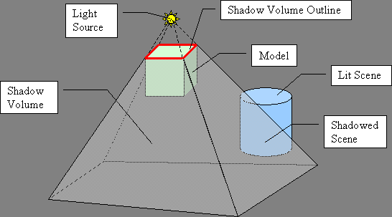
Shadows

Slide 62
Shadows
Any object in the shadow volume is in the shadow, otherwise it is not shadowed
If there are multiple polygons, we can construct a shadow volume for each polygon (more on this later)
To determine if a pixel is in shadow we do the following:
Construct a ray from the eye to the pixel, initialize a counter to 0
For each front facing shadow volume face the ray intersects increment the counter
For each back facing shadow volume face the ray intersects decrement the counter
If the counter is non-zero the pixel is shadowed

Slide 63
Shadows
We could use this approach, but it would be slow
Instead we use a stencil buffer to compute the part of the image that is shadowed
A stencil buffer is a 2D array the same size as the frame buffer or depth buffer, but typically only 8 bits deep
We can modify the stencil buffer and perform tests on it very efficiently
The stencil shadow volume algorithm is a multi-pass algorithm

Slide 64
Shadows
Step One: clear the depth and frame buffers
Step Two: draw model with only ambient light, update the z-buffer, this part is not effected by shadows
Step Three: perform the following three steps for each occluder
Step 3a: construct a closed shadow volume for the occluder
Step 3b: draw front facing (eye space) polygons of shadow volume, don’t update the depth or frame buffer, but increment stencil for each pixel that passes the z buffer test

Slide 65
Shadows
Step 3c: draw the back facing (eye space) polygons of the shadow volume and only update the stencil buffer, for each pixel that passes the z buffer test decrement the stencil buffer
Step Four: Observation: non-zero stencil buffer pixels are in shadow
Draw the model with diffuse and specular lighting, on each pixel do a stencil buffer test, if the stencil buffer is zero add the colour to the frame buffer, otherwise leave the ambient light in the frame buffer

Slide 66
Shadows
The is called an object space algorithm, since the shadow volume is an object, can be viewed as part of the model, computations are done in object space
There are two main problems with this algorithm
If there are a lot of polygons in the occluder there will be a large number of extruded shadow volumes
In step three we could overflow the stencil buffer, plus we will draw a large number of shadow polygons, which take time

Slide 67
Shadows
Solution: construct the silhouette for the occluder from the light source position, determine edges that make up the silhouette
Use these edges to construct the shadow volume
The shadow volume only needs to be computed when the light source or occluder moves, so this computation doesn’t need to be performed on each update
Second problem: if the eye is inside a shadow volume, or it intersects the near clipping plane the stencil buffer computation will be wrong

Slide 68
Shadows
This will produce shadows that shouldn’t exist, or shadows will be missing
The solution is to work the other way around, count the shadow volumes behind the depth buffer, if the count of front and back facing polygons is the same the pixel isn’t in shadow
Can have the same problem with the far clipping plane, but we can easily move it to be past the end of the shadow volume

Slide 69
Shadows
The shadow map algorithm is an image space algorithm, it works in terms of images
Observation: shadows are hidden surface from the light source, if an object is hidden, from the light source perspective it is in shadow
For a spot light, a point light source that produces a cone or frustum of light, we can use our standard rendering algorithms
The position of the light source is the eye position, light frustum become the view frustum, easy to specify in OpenGL

Slide 70
Shadows
Render the complete model and save the depth buffer, this is called the shadow map
It gives the distance from the light source where shadows start for each pixel
Now we render the model from the eye position, using the following modification
For each pixel we transform it to light space, we then test the pixel z against the shadow map, if it is greater the pixel is in shadow only use ambient light, otherwise its not in shadow and use full light model

Slide 71
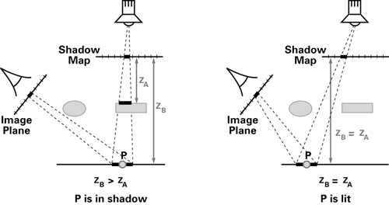
Shadows

Slide 72
Shadows
The shadow map can be stored in a texture for GPU implementation
Matrix from eye coordinates to light coordinates constructed at start of rendering:
Invert world to eye space transformation
Construct world to eye space transformation from the light source
Multiply the two matrices
This works well for spot lights, but what about other kinds of lights?
For a directional light use a parallel project instead of a perspective projection

Slide 73
Shadows
For point lights, which aren’t directional or spot lights we need to use a cube map for a shadow map, we need to render from the light source 6 times
The shadow map is static unless the light source or any of the geometry changes, more frequent than shadow volumes
One advantage, handles shadows from transparent surfaces
If the shadow map is 8 bits deep we can store a partial coverage for smoother shadows

Slide 74
Shadows
One of the main problems with shadow maps is aliasing, the shadow map is computed to a fixed resolution
If the resolution is too low there can be gaps in the shadow
There are some ways of solving these problems, but we won’t go into them

Slide 75
Summary
In this part of the course we have covered local illumination
We have discussed the Phong light model, which is the main model used in computer graphics
We have explored several versions of texture mapping, including procedural textures
Looked at two shadow algorithms

